Slide 1
KUE Department of Computer Science
CHAPTER 5
Compiler Design ()
Intermediate Code Generation

Slide 2
Intermediate Representations
• In a compiler, the front end translates source program into an intermediate representation,
• and the back end generates the target code from this intermediate representation.
• The use of a machine independent intermediate code (IC) is:
• retargeting to another machine is facilitated
the optimization can be done on the machine independent code

Slide 3
Intermediate Representations
• Decisions in IR design affect the speed and efficiency
of the compiler
• Some important IR properties
• Ease of generation
• Ease of manipulation
• Procedure size
• Level of abstraction
• The importance of different properties varies between
compilers
— Selecting an appropriate IR for a compiler is critical

Slide 4
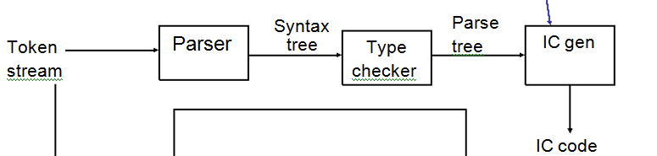
Position of IC

Slide 5
Intermediate Code Generation
• Intermediate language can be many different languages, and the designer of the compiler decides this intermediate language.
– Syntax tree can be used as an intermediate language.
– Postfix notation can be used as an intermediate language.
Three-address code (Quadraples) can be used as an intermediate language
• We will use three address to discuss intermediate code generation
• Three address are close to machine instructions, but they are not actual machine instructions.
Some programming languages have well defined intermediate languages.
• java – java virtual machine
• prolog – warren abstract machine
• In fact, there are byte-code emulators to execute instructions in these intermediate languages.

Slide 6
Types of Intermediate Representations
Three major categories
• Structural
— Graphically oriented
— Heavily used in source-to-source translators
— Tend to be large
• Linear
— Pseudo-code for an abstract machine
— Level of abstraction varies
— Simple, compact data structures
— Easier to rearrange
• Hybrid
— Combination of graphs and linear code
— Example: control-flow graph
Examples:
Trees, DAG
Examples:
3 address code
Stack machine code
Example:
Control-flow graph

Slide 7
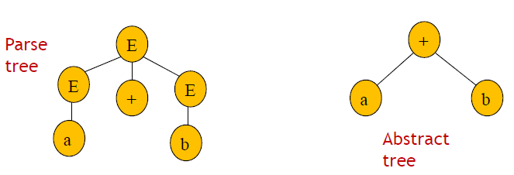
Intermediate languages
• Syntax tree
• While parsing the input, a syntax tree can be constructed.
• A syntax tree (abstract tree) is a condensed form of parse tree useful for representing language constructs.
• For example, for the string a+b, the parse tree in (a) below can be represented by the syntax tree shown in (b);
a
b

Slide 8
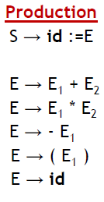
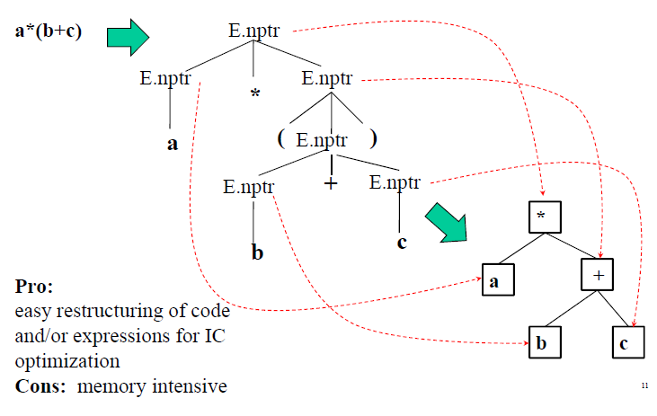
Abstract Syntax Trees

Slide 9
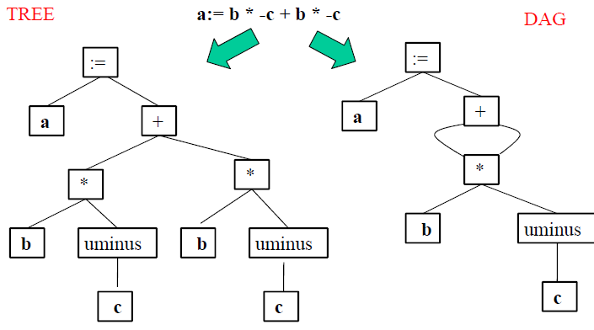
Abstract Syntax Trees versus DAGs

Slide 10
Stack Machine Code
• Originally used for stack-based computers, now Java
• Example:
13+5* becomes
Pros:
• Compact form
• Introduced names are implicit, not
explicit
• Simple to generate and execute code
push 1
push 3
add
push 5
multiply
The value on the top of
the stack at the end (here
18) is a value of the
entire expression
Implicit names take
up no space, where
explicit ones do!

Slide 11
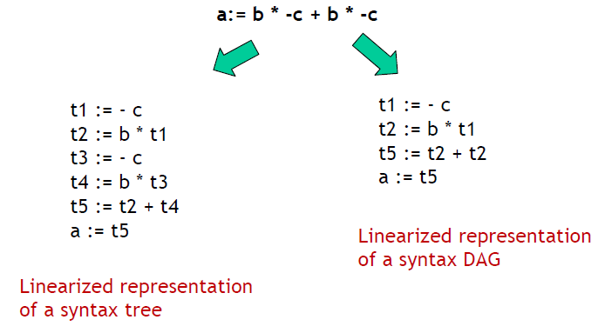
Three-Address Code

Slide 12
Three-Address Code
• A three address code is:
x := y op z
where x, y and z are names, constants or compiler-generated
temporaries; op is any operator.
• But we may also use the following notation for three address
code (much better notation because it looks like a machine
code instruction)
op y,z,x apply operator op to y and z, and store the result in x.
• We use the term “three-address code” because each statement
usually contains three addresses (two for operands, one for the result).

Slide 13
Three-Address Code…
• In three-address code:
• Only one operator at the right side of the assignment is possible, i.e. x + y * z is not possible
• It has been given the name three-address code because such an instruction usually contains three addresses (the two operands and the result)
t1 = y * z
t2 = x + t1

Slide 14
Three-Address Statements
Binary Operator:
op y,z,result or result := y op z
• Where op is a binary arithmetic or logical operator.
• This binary operator is applied to y and z, and the result of the operation is stored in result.
Ex: add a,b,c
mul a,b,c
addr a,b,c
addi a,b,c

Slide 15
Three-Address Statements (cont.)
Unary Operator:
op y,, result or result := op y
• Where op is a unary arithmetic or logical operator.
• This unary operator is applied to y, and the result of
the operation is stored in result.
Ex: uminus a, ,c
not a, ,c
inttoreal a, ,c

Slide 16
Three-Address Statements (cont.)
Copy/ Move Operator: mov y, ,result or result := y
where the content of y is copied into result.
Ex: mov a, ,c
movi a, ,c
movr a,,c
Unconditional Jumps: jmp , ,L or goto L
We will jump to the three-address code with the label L, and
the execution continues from that statement.
Ex: jmp , ,L1 // jump to L1
jmp , ,7 // jump to the statement 7

Slide 17
Three-Address Statements (cont.)
Conditional Jumps: jmprelop y,z,L or if y relop z goto L
We will jump to the three-address code with the label L if the result of y relop z is true, and the execution continues from that statement. If the result is false, the execution continues from the statement following this conditional jump statement.
Ex: jmpgt y,z,L1 // jump to L1 if y>z
jmpgte y,z,L1 // jump to L1 if y>=z
jmpe y,z,L1 // jump to L1 if y==z
jmpne y,z,L1 // jump to L1 if y!=z
Our relational operator can also be a unary operator.
jmpnz y,,L1 // jump to L1 if y is not zero
jmpz y,,L1 // jump to L1 if y is zero
jmpt y,,L1 // jump to L1 if y is true
jmpf y,,L1 // jump to L1 if y is false

Slide 18
Syntax-Directed Translation into Three Address Code
• Syntax directed translation can be used to generate the three address code.
• Generally, either:
• the three-address code is generated as an attribute of the attributed parse tree or
• the semantic actions have side effects that write the three address code statements in a file.
• When the three-address code is generated, it is often necessary to use temporary variables and temporary names.

Slide 19
Syntax-Directed Translation into Three-Address Code
• The following functions are used to generate 3-address code:
• newtemp() - each time this function is called, it gives
distinct names that can be used for temporary variables.
– returns t1, t2,…, tn in response to successive calls
• newlabel() - each time this function is called, it gives
distinct names that can be used for label names.
• gen() - to generate a single three address statement
given the necessary information.
• variable names and operations.

Slide 20
Cont…
• gen will produce a three-address code after concatenating all the parameters.
• For example:
• If id1.lexeme = x, id2.lexeme =y and id3.lexeme = z:
• gen (id1.lexeme, ‘:=’, id2.lexeme, ‘+’, id3.lexeme)
• will produce the three-address code : x := y + z
• Note: variables and attribute values are evaluated by gen before being concatenated with the other parameters.

Slide 21
Cont…
• Deal with assignments.
• Use attributes:
– E.place: the name that will hold the value of E
• Identifier will be assumed to already have the place attribute defined.
– E.code: hold the three address code statements that evaluate E (this is the ‘translation’ attribute).
-|| : Code concatenation operator

Slide 22
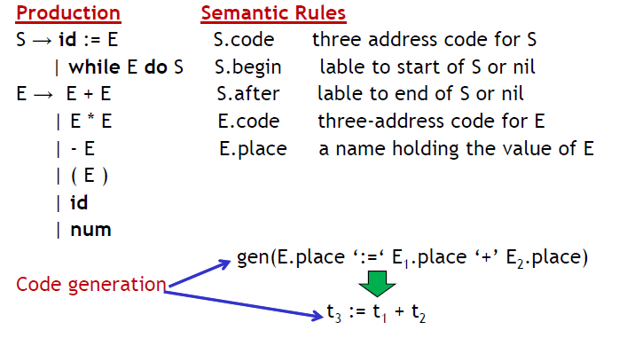
Cont…

Slide 23
Implementation of Three-Address Statements:
• The description of three-address instructions specifies the
components of each type of instruction.
• However, it does not specify the representation of these
instructions in a data structure.
• In a compiler, these statements can be implemented as objects or as records with fields for the operator and the operands.
• Three such representations are:
– Quadruples
– Triples and
– Indirect triples

Slide 24
Cont…
– Quadruples A quadruple (or just "quad') has four fields, which we call op, arg1, arg2, and result
– Triples: A triple has only three fields, which we call op, arg1, and arg2.
– Indirect Triples: consists of a listing of pointers to triples, rather than a listing of triples themselves.
• The benefit of Quadruples over Triples can be seen in an optimizing compiler, where instructions are often moved around.
• With quadruples, if we move an instruction that computes a temporary t, then the instructions that use t require no change.
• With triples, the result of an operation is referred to by its position, so moving an instruction may require to change all references to that result.
• This problem does not occur with indirect triples.

Slide 25
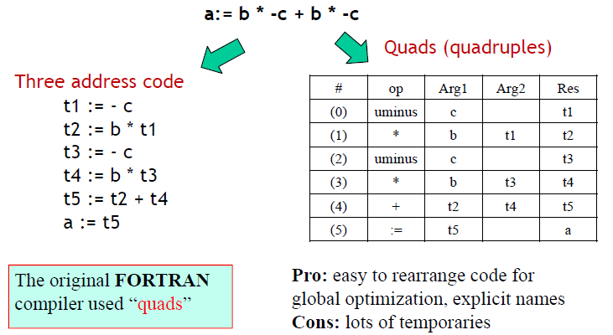
Quads (quadruples)

Slide 26
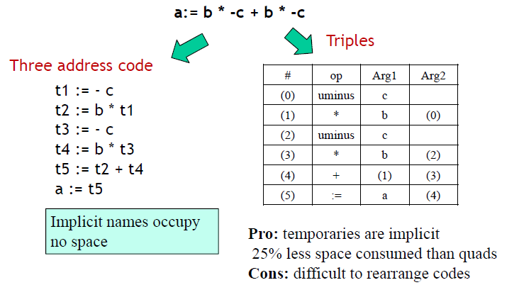
Triples

Slide 27
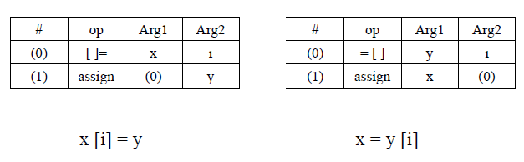
More triplet representations
• Major tradeoff between quads and triples is compactness
versus ease of manipulation
— In the past compile-time and space was critical
— Today, speed may be more important

Slide 28
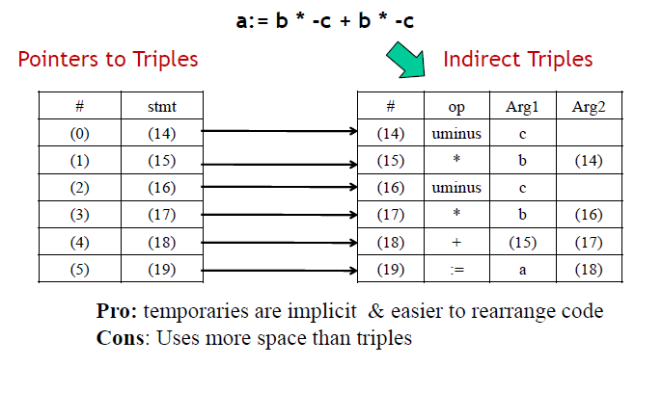
Indirect Triples

Slide 29
Exercises
• Translate the arithmetic expression a + -(b + c) into
a) A syntax tree and DAG.
b) Quadruples.
c) Triples.
d) Indirect triples
Note: use the previous production rule

Slide 30
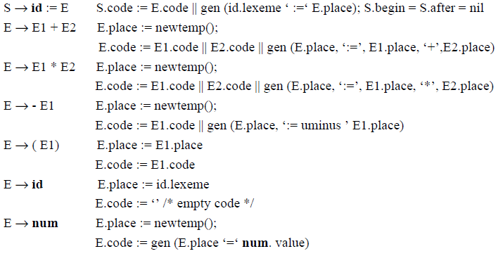
Syntax-Directed Translation into Three-Address Code
Three address code for an assignment statement and an expression
Productions Semantic actions
|| : Code
concatenation
operator

Slide 31
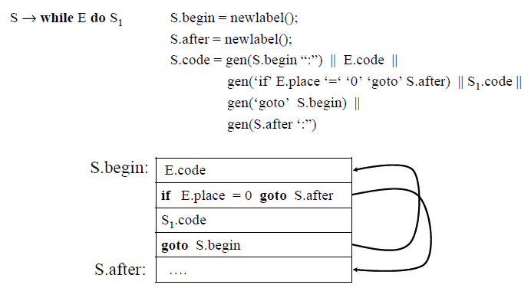
Syntax-Directed Translation (cont.)
Three address code for an assignment statement and an expression

Slide 32
Syntax-Directed Translation (cont.)
S → if E then S1 else S2 S.else = newlabel();
S.after = newlabel();
S.code = E.code ||
gen(‘if’ E.place ‘=’’0’ ‘goto’ S.else) ||
S1.code ||
gen(‘goto’ S.after) ||
gen(S.else ‘:”) || S2.code ||
gen(S.after ‘:”)
E → E < E E.place=newtemp();
E.code = E1.code || E2.code ||
gen (E.place, ‘=‘, E1.place, ‘<‘, E2.place)

Slide 33
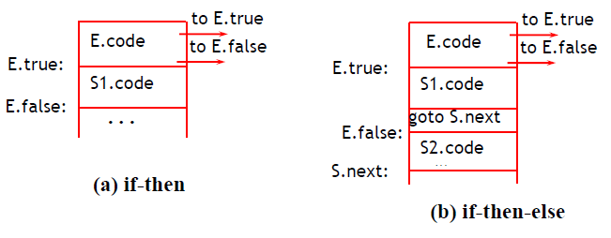
code for flow-of-control statements

Slide 34
Three address code for Declarations
• The declaration is used by the compiler as a source of type information that it will store in symbol table.
• While processing the declaration, the compiler reserves:
– memory location for the variables and
– stores the relative address of each variable in the symbol table.
• In this section, we use:
– variables,
– attributes and
– procedure that help processing of declaration.

Slide 35
Three address code for Declarations
• The compiler maintains a global offset variable that indicates the first address not yet allocated.
• Initially, offset is assigned 0.
• Each time an address is allocated to a variable, the offset is incremented by the width of the data object denoted by the name.
• The procedure enter (name, type, address) creates a symbol
table entry for name, give it the type type and the relative address address.
• The synthesized attributes name and width for non-terminal T are also used to indicate the type and number of memory units taken by objects of that type.

Slide 36
Translation scheme for declaration
P →M D
M → € { offset=0 }
D →D ; D
D → id : T {enter(id.name,T.type,offset);offset=offset+T.width }
T → int { T.type=int; T.width=4 }
T → real { T.type=real; T.width=8 }
T → array[num] of T1 { T.type=array(num.val,T1.type);
T.width=num.val*T1.width }
T → ^ T1 { T.type=pointer(T1.type); T.width=4 }
where enter crates a symbol table entry with given values.

Slide 37
Example
integer = 4 byte, real = 8 byte, pointer = 4 byte
Var :
x : integer
y : real
t : array [10] of integer
v : ^ integer
id type offset
x integer 0
y real 4
t array[10] of int 12
v pointer (integer) 52
array = 10 * 4 + 12

Slide 38
Read about
Three-address code for assignment statement and expressions (including array references)
Decorated parse tree

Slide 39
?

